Slide 1
THE BISECTION METHOD

Slide 2
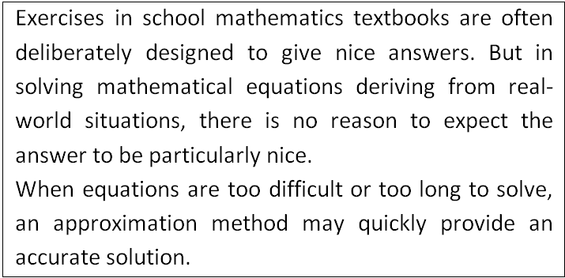
Sometimes it’s more efficient to find an approximate answer

Slide 3
Assumptions

Slide 4
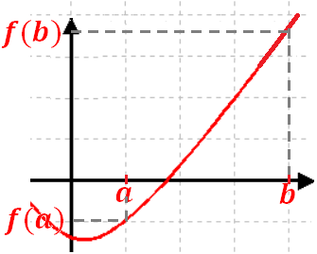
Example with f(b) > 0 > f(a)

Slide 5
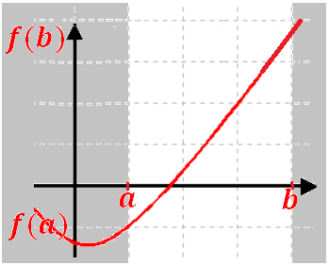
Example with f(b) > 0 > f(a)

Slide 6
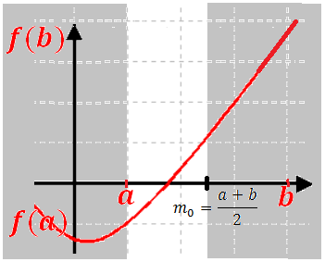
Example with f(b) > 0 > f(a)

Slide 7
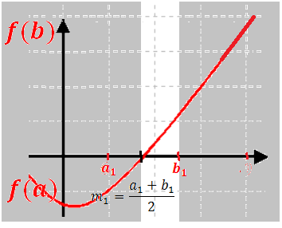
Example with f(b) > 0 > f(a)

Slide 8
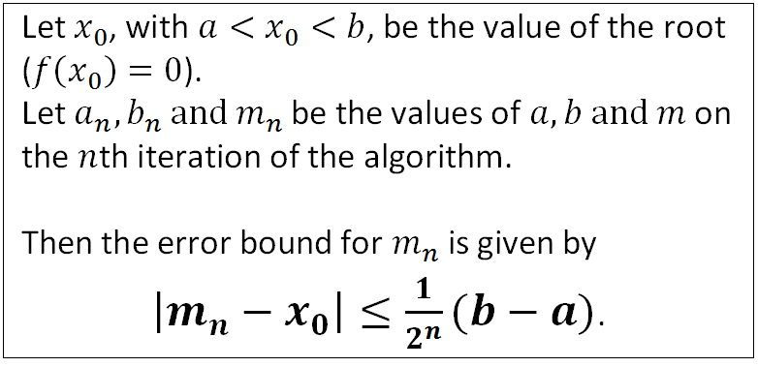
Error bounds

Slide 9
Advantages and disadvantages of the bisection method

Slide 10
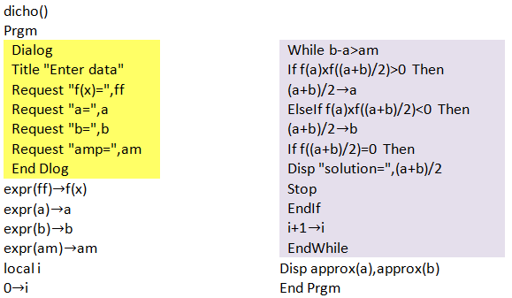
Program in TI basic

Slide 11
Other methods

