Slide 1
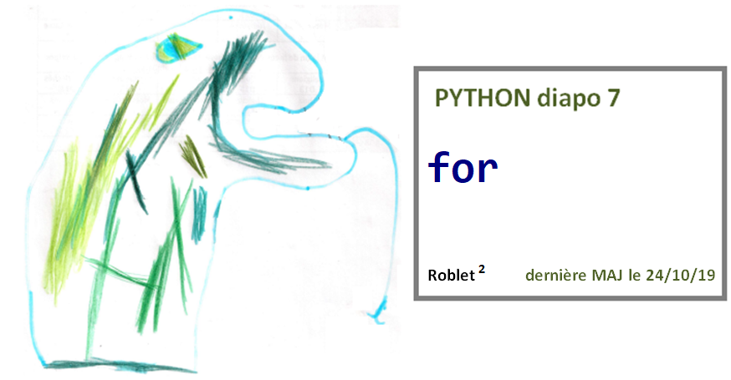

Slide 2
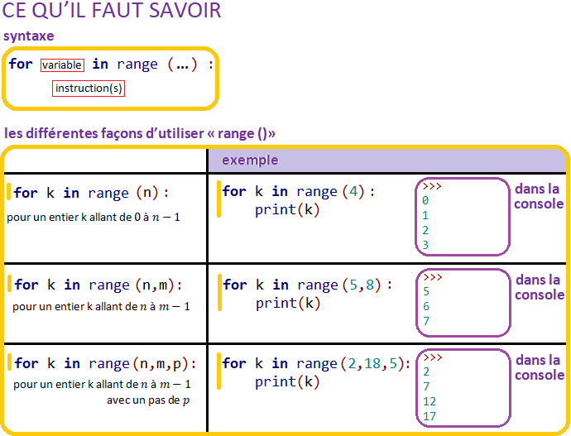
Diapo 7

Slide 3
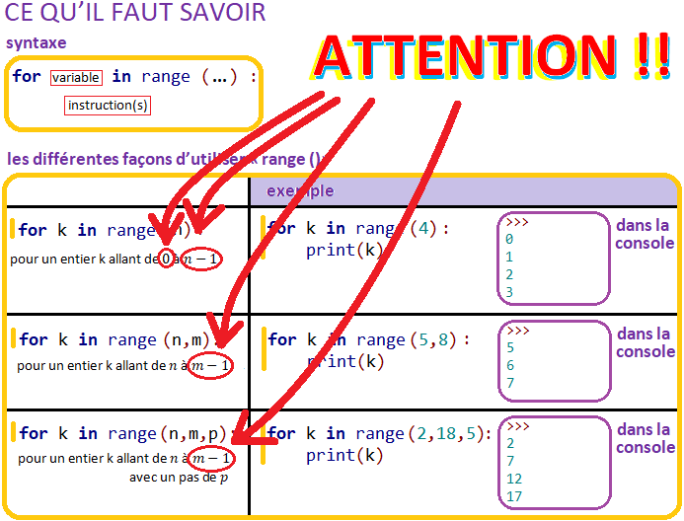
Diapo 7

Slide 4
Diapo 7

Slide 5
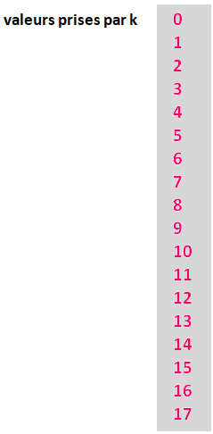
Diapo 7

Slide 6
Diapo 7

Slide 7
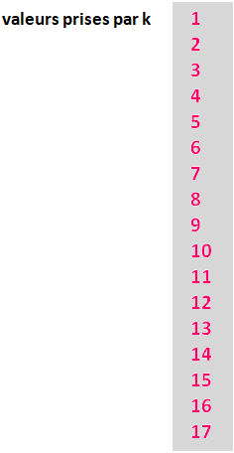
Diapo 7

Slide 8
Diapo 7

Slide 9
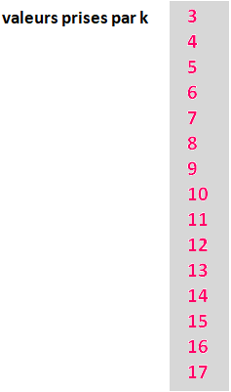
Diapo 7

Slide 10
Diapo 7

Slide 11
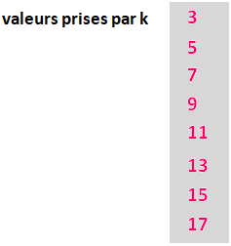
Diapo 7

Slide 12
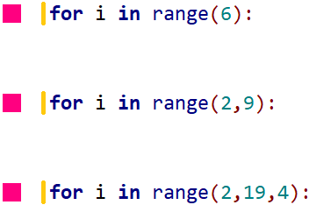
Diapo 7

Slide 13
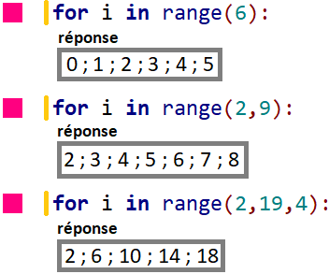
Diapo 7

Slide 14
Diapo 7

Slide 15
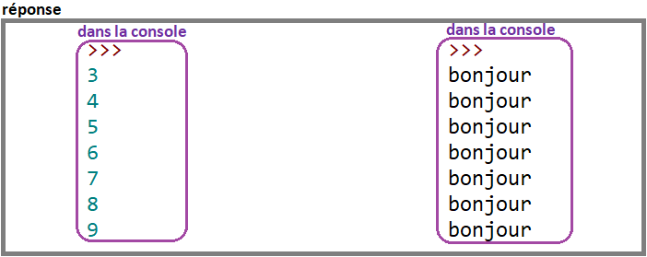
Diapo 7

Slide 16
Diapo 7

Slide 17
Diapo 7

