Slide 1
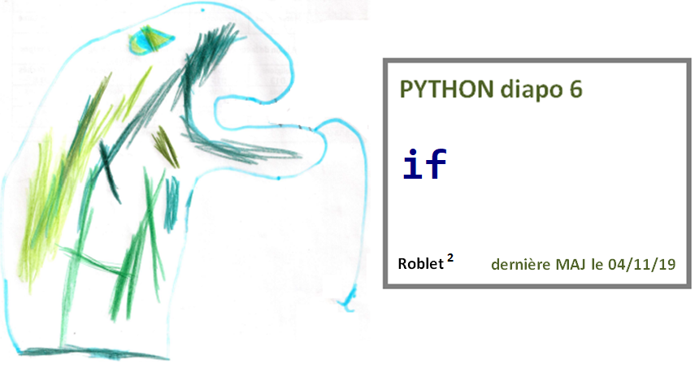

Slide 2
Diapo 6

Slide 3
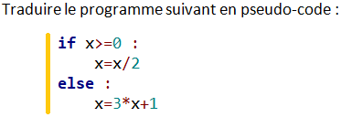
Diapo 6

Slide 4
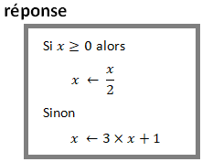
Diapo 6

Slide 5
Diapo 6

Slide 6
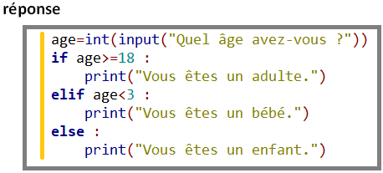
Diapo 6

Slide 7
Diapo 6

Slide 8
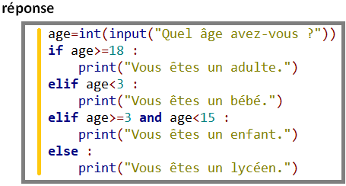
Diapo 6

