Slide 1
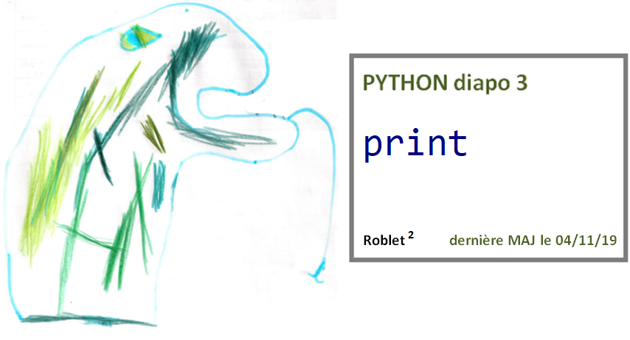

Slide 2
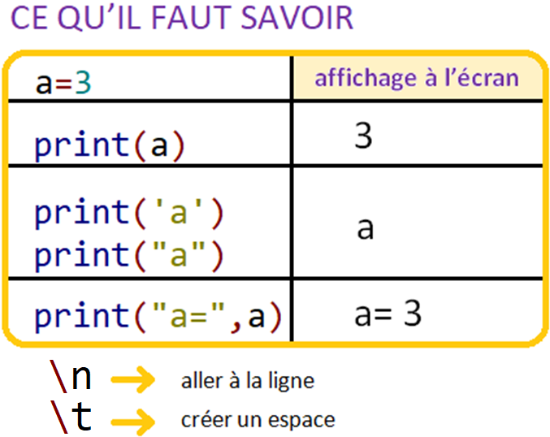
Diapo 3

Slide 3
Diapo 3

Slide 4
Diapo 3

Slide 5
Diapo 3

Slide 6
Diapo 3

Slide 7
Diapo 3

Slide 8
Diapo 3

Slide 9
Diapo 3

Slide 10
Diapo 3

Slide 11
Diapo 3

Slide 12
Diapo 3

Slide 13
Diapo 3

Slide 14
Diapo 3

Slide 15
Diapo 3

Slide 16
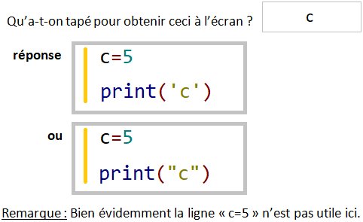
Diapo 3

Slide 17
Diapo 3

Slide 18
Diapo 3

Slide 19
Diapo 3

Slide 20
Diapo 3

Slide 21
Diapo 3

Slide 22
Diapo 3

Slide 23
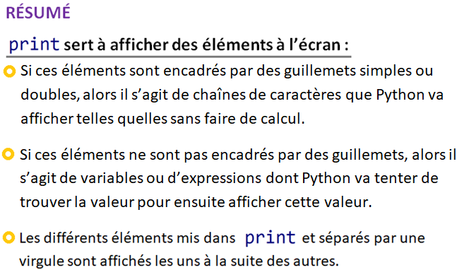
Diapo 3

