Slide 1
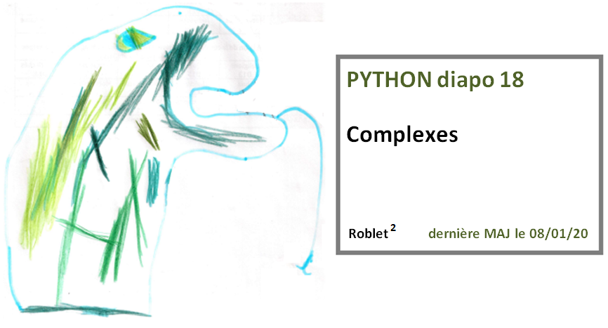

Slide 2
Diapo 18 Complexes

Slide 3
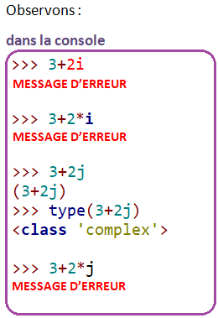
Diapo 18 Complexes

Slide 4
Diapo 18 Complexes

Slide 5
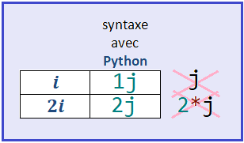
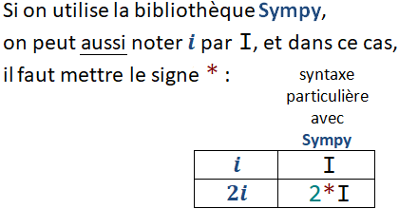
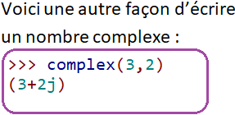
Diapo 18 Complexes

Slide 6
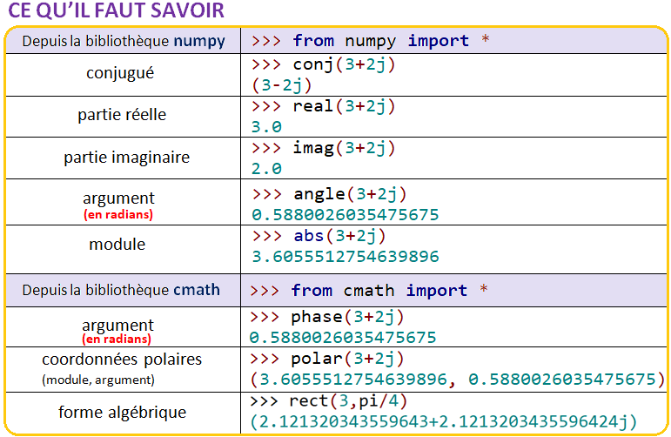
Diapo 18 Complexes

Slide 7
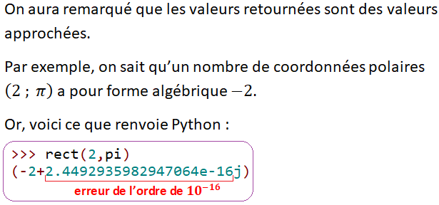
Diapo 18 Complexes

